Slide 1
Group 4.1
Hussin Mohsen, Yekaterina Kovalyova, Acer XU

Slide 2
Intro
The gene 3VKO codes for the Galectin-8 protein, which functions as a Beta-galactoside-binding lectin.
Galectin-8 is thought to act as a membrane damage sensor during infections, and restricts the proliferation of pathogens by targeting them for autophagy.

Slide 3
Intro
Galectin-8 also detects endosomal membrane rupture events by binding beta-galactoside ligands on the lumenal side of endosome membranes, which are exposed to the cytoplasm following rupture of the endosome. The mutation of interest studied here is F19Y, a mutation of a phenylalanine to a tyrosine.

Slide 4
F19
From an initial side-chain chemistry standpoint, this mutation should be relatively minor, as it occurs away from the binding pocket, and the residue does not appear to play a major role in the interaction of the two domains of the protein.
F19 can be found as part of a beta-barrel structure near the interface of the domains, but was not found to make any direct contacts in the interface

Slide 5
F19Y
From a space-filling perspective, the tyrosine mutation is about as large as phenylalanine, and therefore may disrupt the structural stability of the protein, but not in any majorly appreciable way.
The larger –OH group does decrease the amount of conformational space available
F19I and F19L both are stabilizing mutations as well

Slide 6
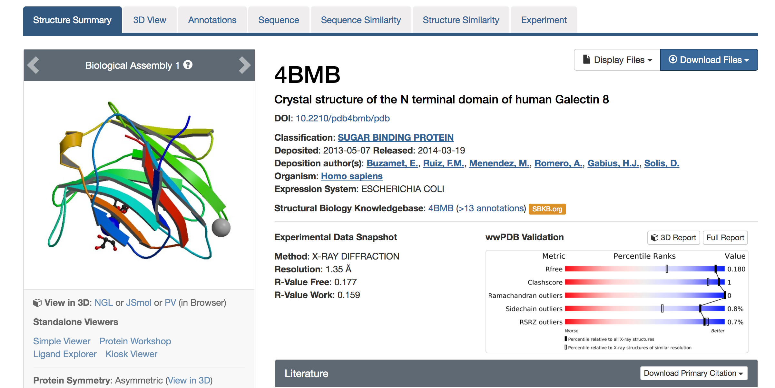
Pipeline
Rosetta 2017.08
4BMB PDB file
Six steps
Relaxing the protein PDB file
Repacking the structure
Calculating Delta G of the wild type protein
Repacking the structure with a point mutation at position 19
Calculating Delta G' of the mutated protein
Calculating the change in binding energy.

Slide 7
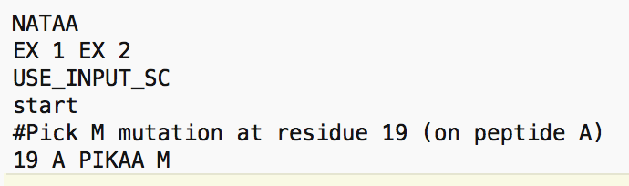
Pipeline
Commands
Step 1 relax.default.macosclangrelease -s 4bmb.pdb -ignore_unrecognized_res -out:path:pdb results -out:file:scorefile results/relax_4bmb.sc -nstruct 1
Steps 2-5 rosetta_scripts.default.macosclangrelease -parser:protocol mutation_script.xml -s 4bmb_relaxed.pdb -ignore_unrecognized_res -out:path:pdb results -out:path:score results -nstruct 1
Step 6 tail -n 3 4bmb_relaxed_M.pdb | awk 'BEGIN{i=0}{if($2 != "") {a[i] = $2; i++}}END{print a[0]-a[1]}'

Slide 8
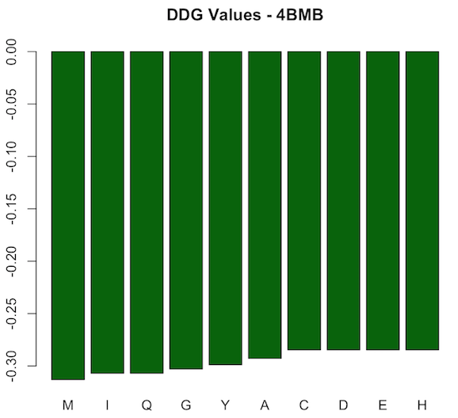
Pipeline
10 AA point mutations at position 19 of 4BMB
All stabilizing ddG < 0
Most stabilizing: M
Least stabilizing: C, D, E, and H

Slide 9
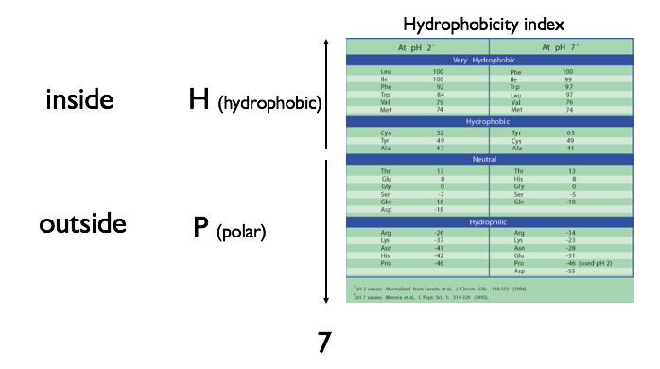
Pipeline
Why M?
M & T are “very hydrophobic”
Other AAs among chosen 10 are either hydrophilic or “hydrophobic”

Slide 10
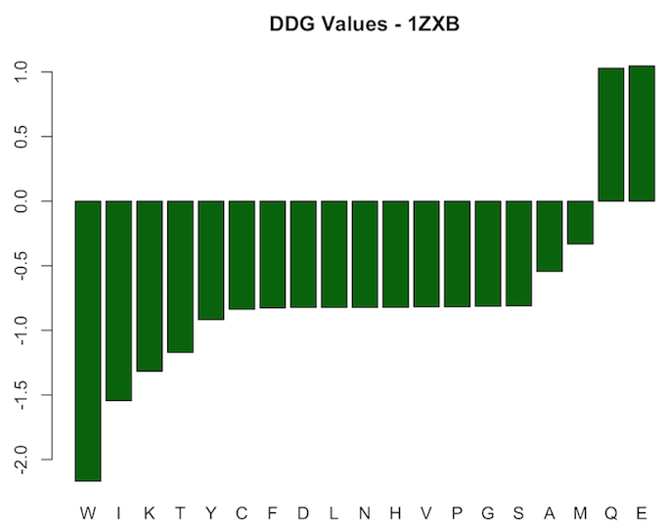
Pipeline
10 AA point mutations at position 19 of 1ZXC
Most are stabilizing (ddG < 0), 2 are destabilizing (ddG > 0)

Slide 11

Pipeline
Changes in stability might lead to changes in protein function

Slide 12
WT vs. Mutant: Repulsive Energy
To plot, convert each column into 2-dimensional array
5 | 5 | 5 | 5 | 5
10 | 10 | 10 | 10 | 10
15 | 15 | 15 | 15 | 15
20 | 20 | 20 | 20 | 20
25 | 25 | 25 | 25 | 25
χ₁
χ₁ | χ₂ | U
5 | 5 | 3
5 | 10 | 3
5 | 15 | 3
5 | 20 | 2
5 | 25 | 1
10 | 5 | 0
10 | 10 | 1
10 | 15 | 2
10 | 20 | 3
10 | 25 | 3
5 | 10 | 15 | 20 | 25
5 | 10 | 15 | 20 | 25
5 | 10 | 15 | 20 | 25
5 | 10 | 15 | 20 | 25
5 | 10 | 15 | 20 | 25
χ₂
…
3 | 3 | 3 | 2 | 0
1 | 2 | 3 | 3 | 3
…
…
U

Slide 13
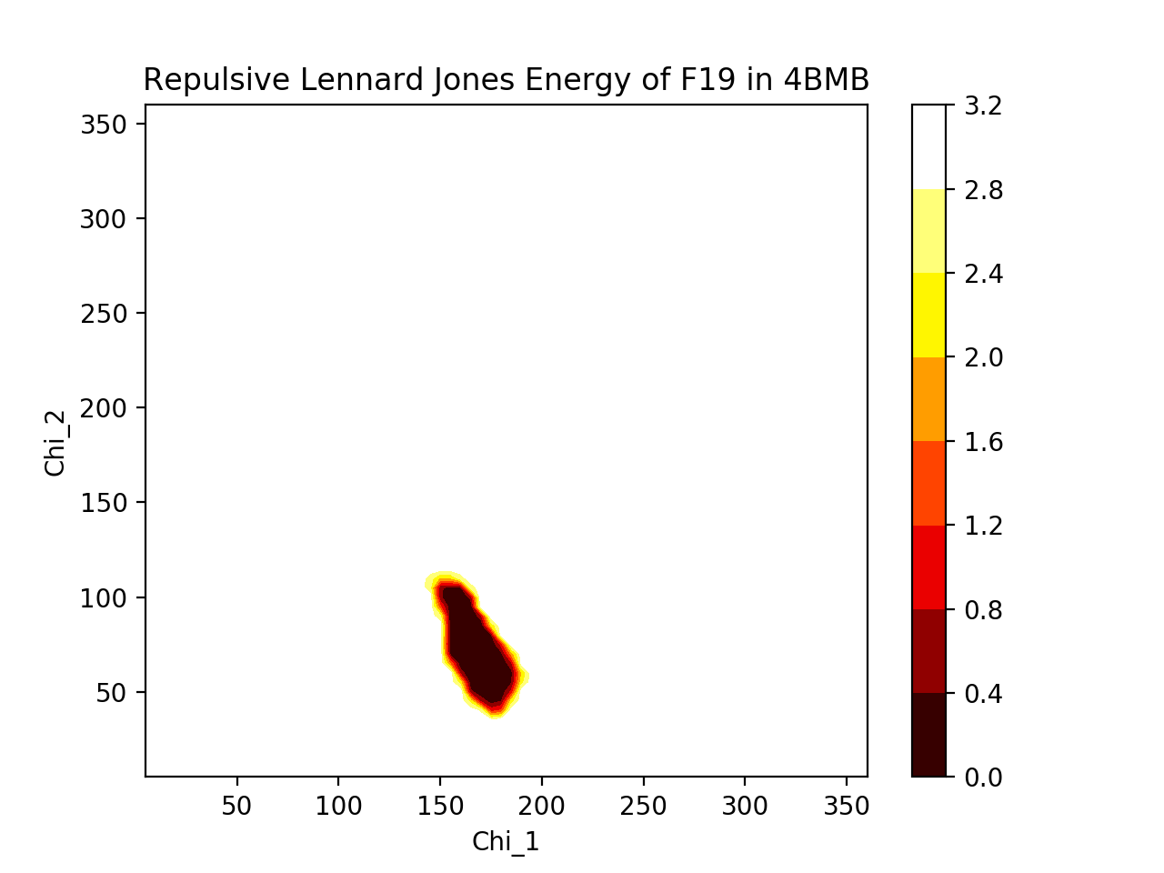
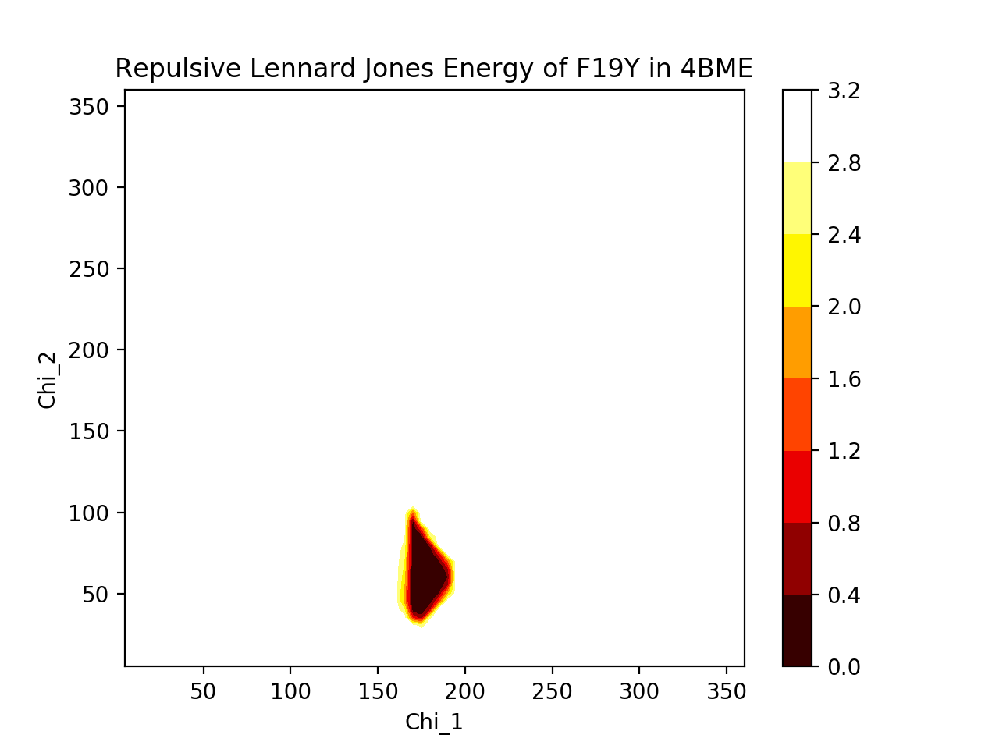
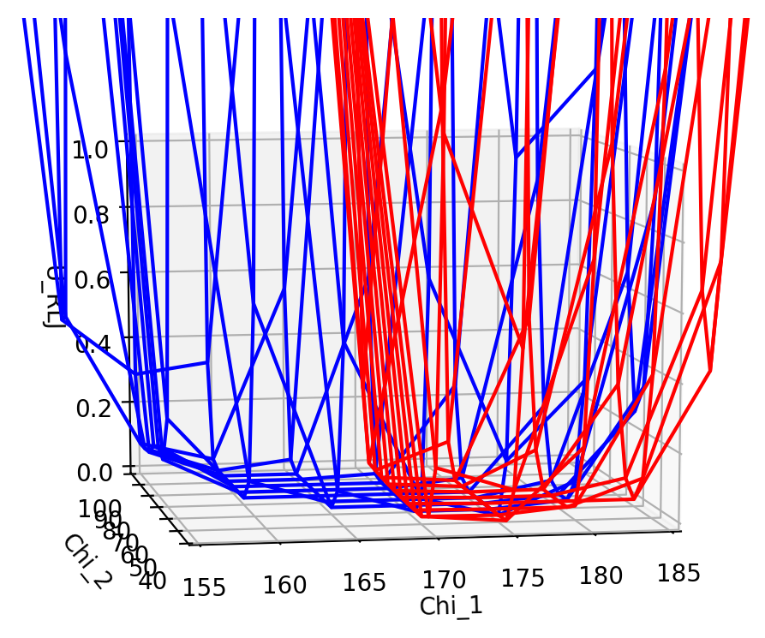
WT vs. Mutant: Repulsive Energy
blue: F19
red: F19Y

Slide 14
WT vs. Mutant: Repulsive Energy
Very similar energy dips
Dihedral angles of Y should roughly match those of F
-OH of Y probably decreases allowable conformations
blue: F19
red: F19Y

Slide 15
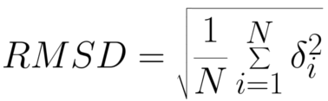
WT vs. Mutant: RMSD
Take backbone heavy atoms C, N, O, Cα
At each residue, get x, y, z coordinates of each atom
Get distance between atoms in WT and corresponding atoms in mutant
Calculate RMSD of the 4 atoms at each residue

Slide 16
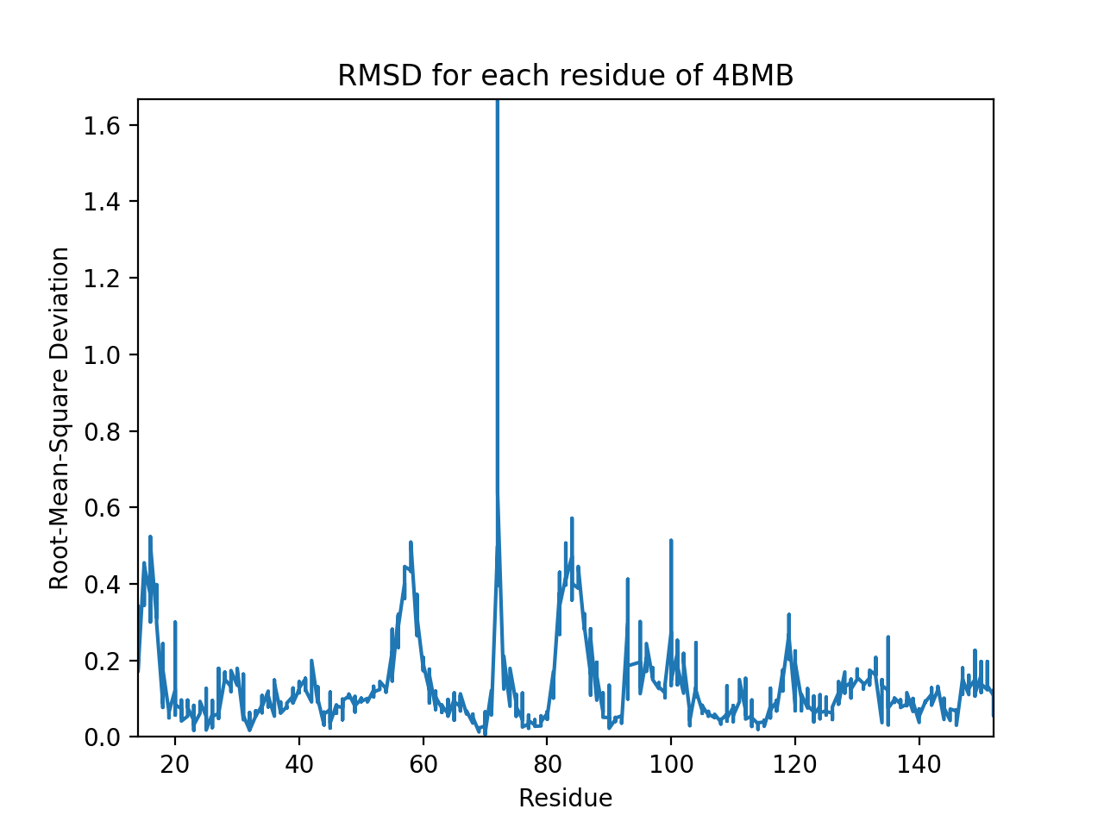
WT vs. Mutant: RMSD

